Slide 1
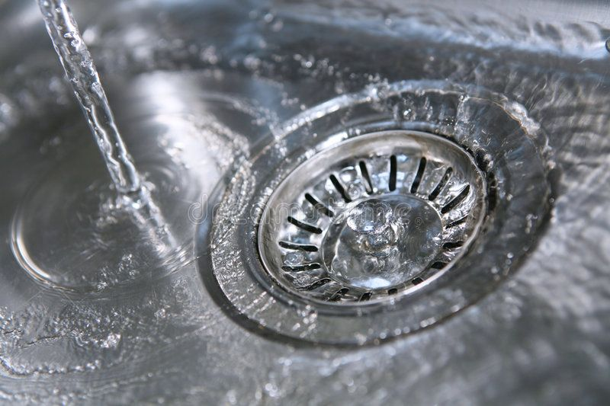
GRADIENT,DIVERGENCE AND CURL NAZMUL KADER CHOWDHURY

Slide 2

DIFFERENTIAL OPERATOR DEL
$∇=\frac{∂}{∂x}i+\frac{∂}{∂y}j+\frac{∂}{∂z}$k
Purpose: It forms the foundation for operations like gradient, divergence, and curl.

Slide 3
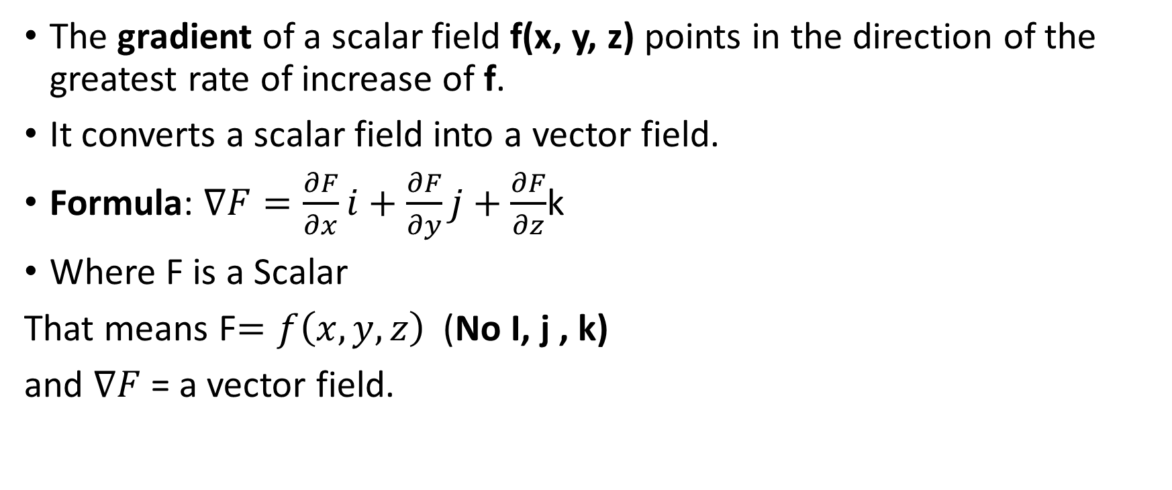
GRADIENT (Scalar to vector)
The gradient of a scalar field f(x, y, z) points in the direction of the greatest rate of increase of f.
It converts a scalar field into a vector field.
Formula: $∇F=\frac{∂F}{∂x}i+\frac{∂F}{∂y}j+\frac{∂F}{∂z}$k
Where F is a Scalar
That means F$=f\left(x, y,z\right)$ (No I, j , k)
and $∇F$ = a vector field.

Slide 4
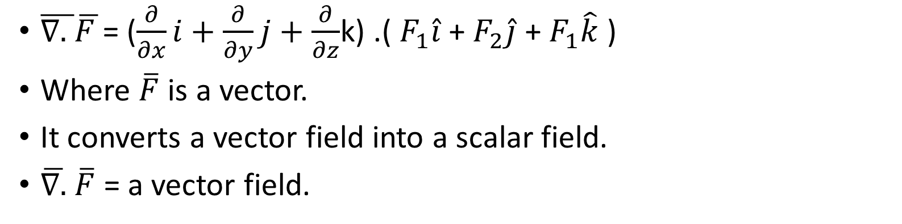
Divergence (Vector to Scalar)
$\overline{∇. }\overline{F }$= ($\frac{∂}{∂x}i+\frac{∂}{∂y}j+\frac{∂}{∂z}$k) .( $F_{1}\hat{i}$ + $F_{2}\hat{j}$ + $F_{1}\hat{k}$ )
Where $\overline{F}$is a vector.
It converts a vector field into a scalar field.
$\overline{∇.}$ $\overline{F}$ = a vector field.

Slide 5
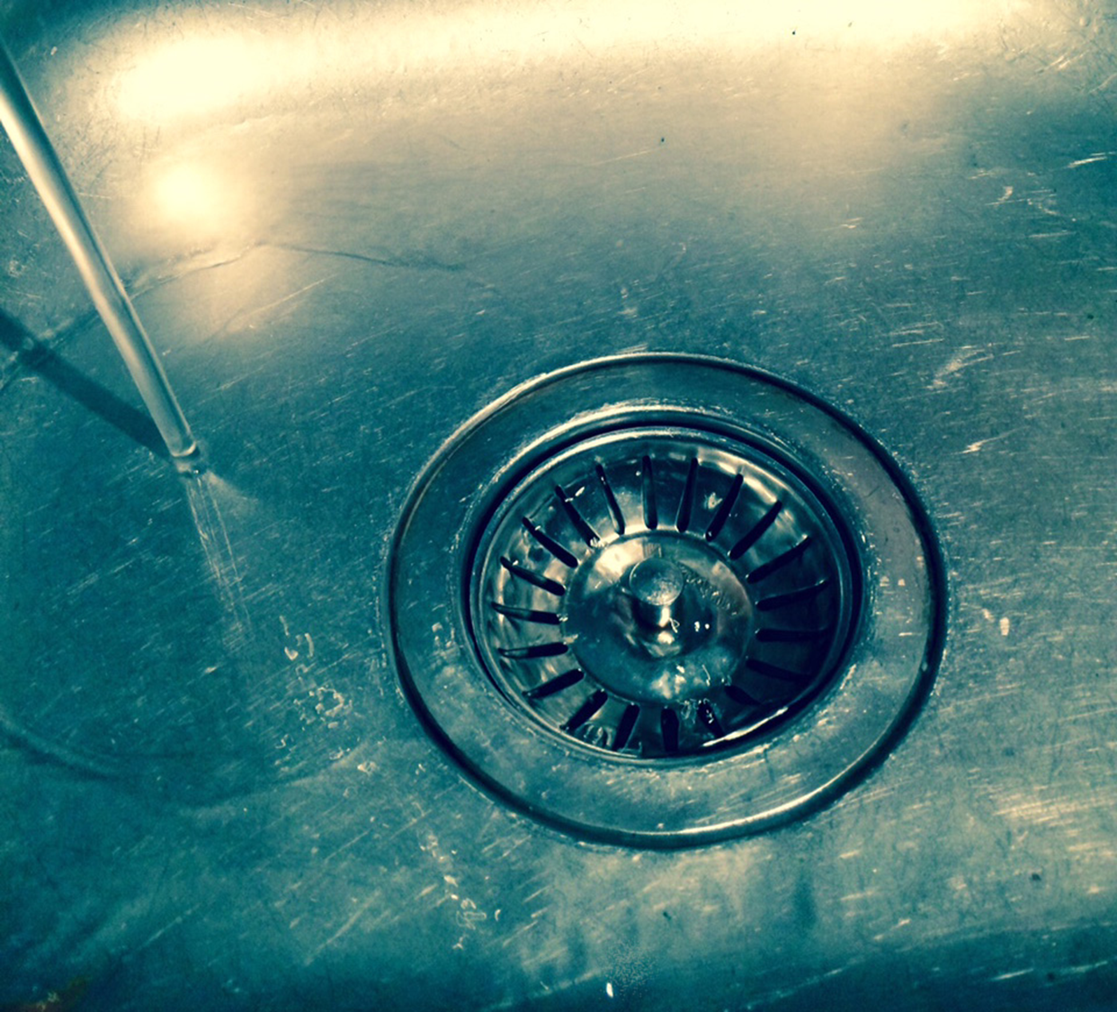
What is divergence?
If ∇⋅F>0, more fluid is leaving a region than entering → Source (Expansion).
If ∇⋅F<0, more fluid is entering than leaving → Sink (Compression).
If ∇⋅F=0, the fluid is incompressible → Steady flow.

Slide 6
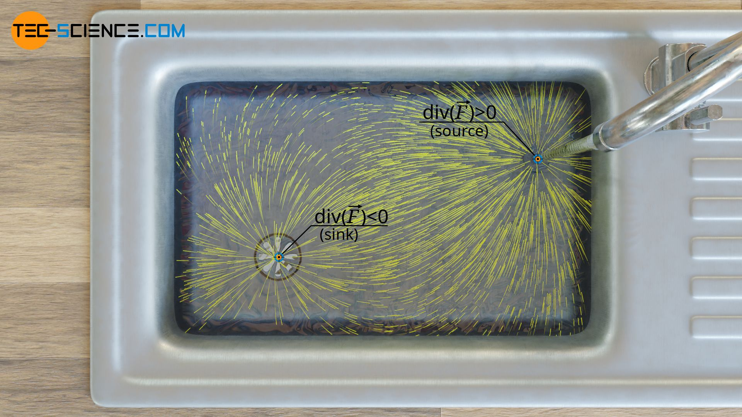
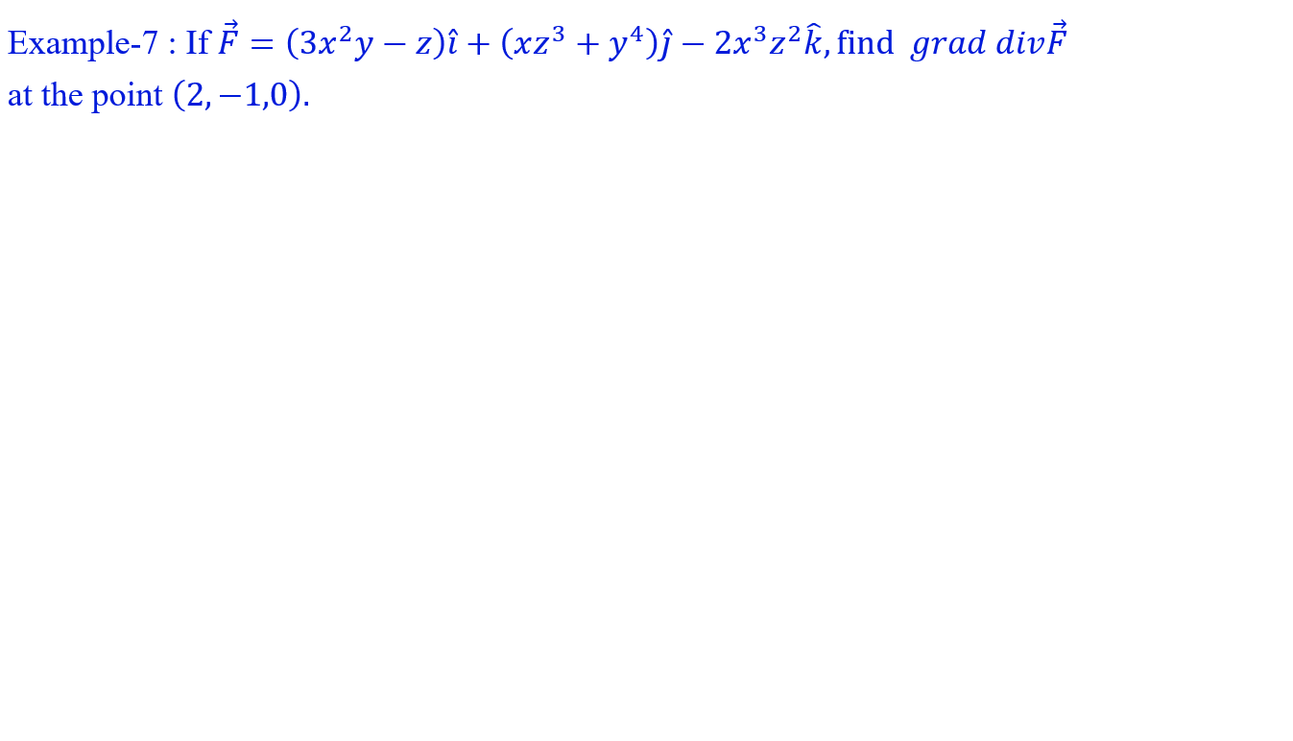

Slide 7
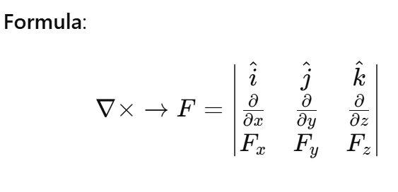
CURL (VECTOR TO VECTOR)
Definition: The curl of a vector field F measures the rotation or circulation of the field.

Slide 8
What is Curl?
(19) Curl - Grad, Div and Curl (3/3) - YouTube
If ∇×V=0, the fluid moves without rotation (purely translational).
If ∇×V=0, the flow has a rotational component (like a whirlpool or tornado).

